Slide 1

AIML-WORKSHOP PROJECT
IPL WIN PREDICTOR
MODEL
PRESENTED BY :
SHARIT VAISHNAV - BT22CSA042
PRAJWAL PRASAD - BT22CSA043
KHUSHWANT NIMORE - BT22CSA044
HARSH SUHAN - BT22CSA034

Slide 2




PROBLEM STATEMENT
DEVELOP A MACHINE LEARNING MODEL CAPABLE OF PREDICTING THE WINNING TEAM IN IPL MATCHES WITH A HIGH DEGREE OF ACCURACY.
Briefly mention the impact on various stakeholders:
Fans: Gain insights and make informed predictions about upcoming matches.
Fantasy Players: Make strategic team selections based on data-driven predictions.
Sports Analysts & Commentators: Leverage model insights for analysis and commentary.

Slide 3
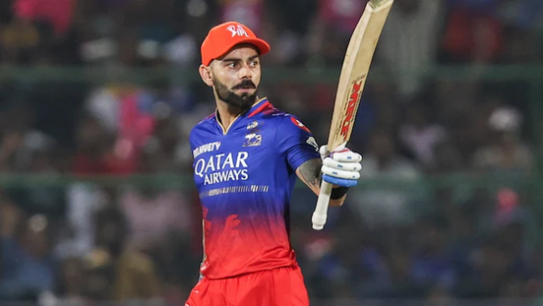
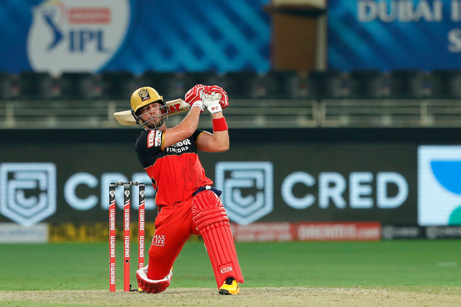
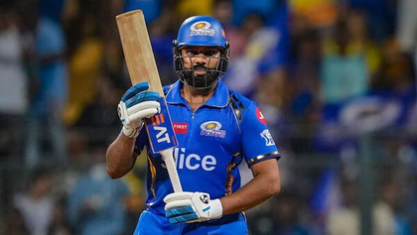
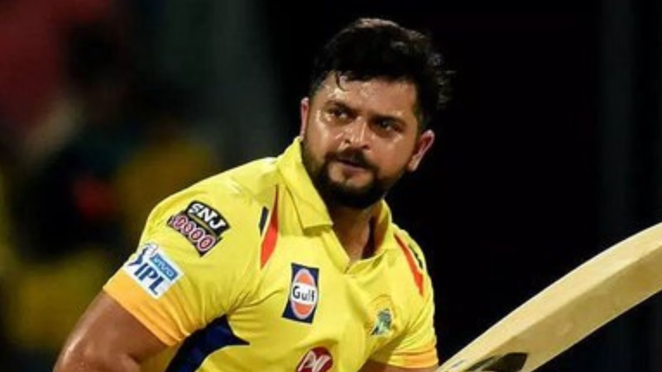
INTRODUCTION :
IPL: HIGHLIGHT THE INDIAN PREMIER LEAGUE (IPL) AS A PROFESSIONAL TWENTY20 CRICKET LEAGUE FEATURING TOP PLAYERS FROM AROUND THE WORLD. EMPHASIZE ITS IMMENSE POPULARITY IN INDIA AND VIEWERSHIP WORLDWIDE.
VIRAT KOHLI
AB DE
VILLIERS
Our aim is to create a classification model to predict IPL match winners using historical data and relevant features.
ROHIT SHARMA
Enhance fan engagement with the IPL through informed predictions.
Assist fantasy cricket players in optimizing their team selections.
Provide valuable insights for sports analysts and commentators during broadcasts.
SURESH RAINA

Slide 4
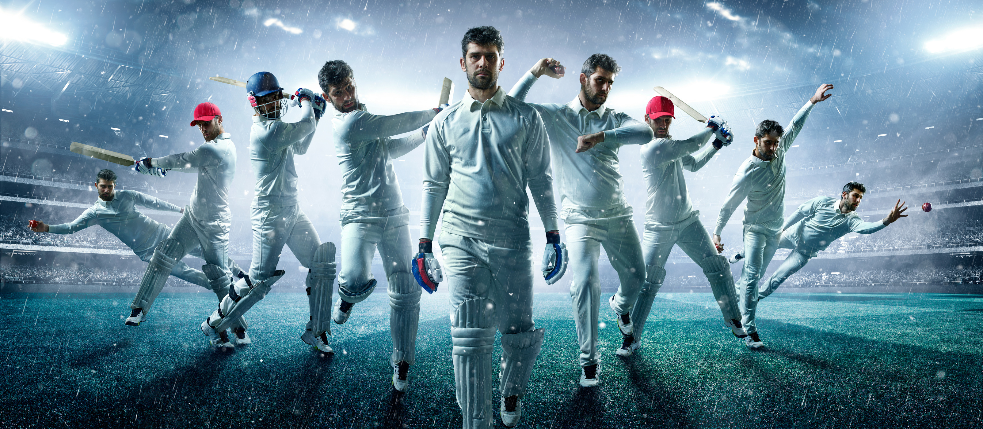
DATA DESCRIPTION
This project leverages three datasets obtained from Kaggle to train a machine learning model for predicting IPL match winners.
PLAYERS DATASET
MATCHES DATASET
DELIVERIES DATASET

Slide 5
PLAYERS DATA
Player ID: Unique identifier for each player.
Player Name: Full name of the player.
Batting Hand: Specifies whether the player bats right-handed or left-handed.
Bowling Style: Specifies the player's primary bowling style (e.g., fast bowler, leg spinner).
Nationality: Player's country of origin.
MATCHES DATA
Match ID: Unique identifier for each match.
Season: Year in which the match was played.
Tournament Stage: Stage of the tournament (e.g., League Stage, Playoffs, Final).
Teams Playing: Names of the two teams competing in the match.
Venue: Location where the match was played.
Toss Winner: Team that won the toss.
Batting First: Team that chose to bat first.
First Innings Score: Total score of the team batting first.
Second Innings Score: Total score of the team batting second.
Winner: Team that won the match.
Margin of Victory: Number of runs or wickets by which the winning team won.

Slide 6
DELIVERIES DATA
Match ID: Connects deliveries to the specific match they belong to.
Ball Number: Ball number within the innings.
Batsman: The batsman facing the delivery.
Bowler: The bowler bowling the delivery.
Runs Scored: Number of runs scored off the delivery.
Wicket Taken: Whether a wicket fell on this delivery (Yes/No).
Extras: Number of extra runs awarded (byes, leg byes, wides, etc.).
Dismissal Type: If a wicket fell, the type of dismissal (e.g., caught out, bowled, LBW).

Slide 7
MODEL DEVELOPMENT
Machine Learning Classification: Briefly explain that classification models categorize data points into predefined classes. In this case, the classes are the two teams playing the IPL match.
Classification Algorithm(s): Mention the specific classification algorithm used in your project. Here, you'll state:
Pipelining Approach: We employed a pipelining approach to streamline data preparation and model training. This approach combines multiple steps into a single unit, improving efficiency.
Model Training Process: Briefly describe the model training process using pipelining:
Data Preprocessing: Within the pipeline, data cleaning and transformation steps are applied (e.g., handling missing values, converting categorical features).
Model Training: The chosen classification algorithm (e.g., Random Forest, Logistic Regression) is integrated into the pipeline and learns from the preprocessed data to identify patterns and relationships between features and the winning team.

Slide 8
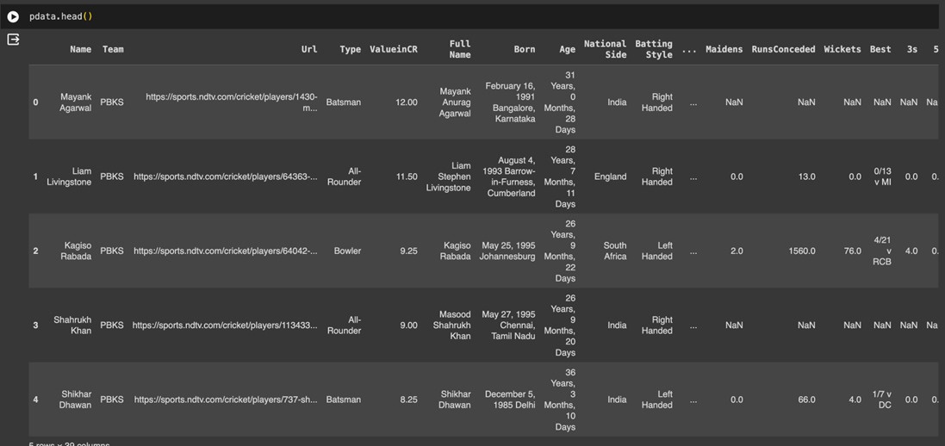
DATA PREPROCESSING / DATA WRANGLING:
Within the pipeline, data cleaning and transformation steps are applied (e.g., handling missing values, converting categorical features).
Model Training: The chosen classification algorithm (e.g., Random Forest, Logistic Regression) is integrated into the pipeline and learns from the preprocessed data to identify patterns and relationships between features and the winning team.
DATA DESCRIPTION

Slide 9

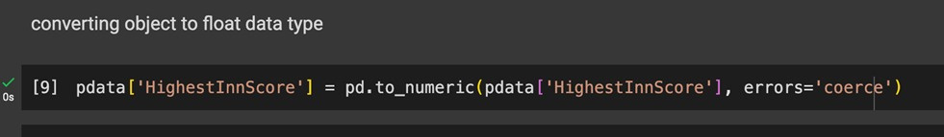
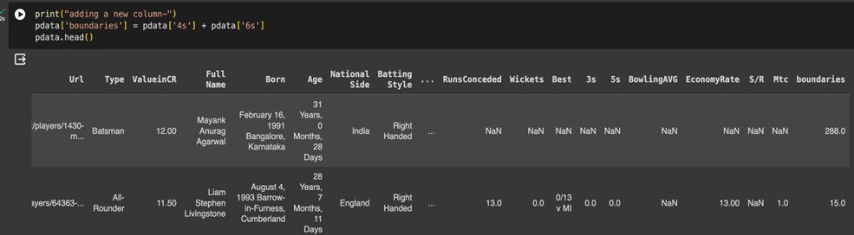

Slide 10

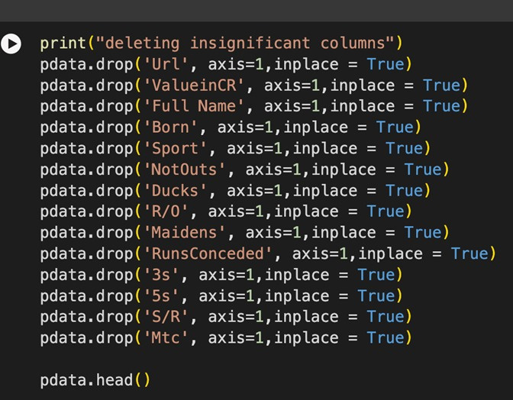
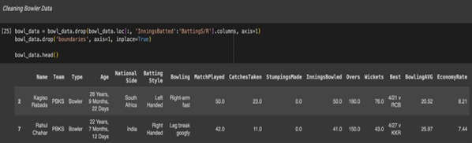
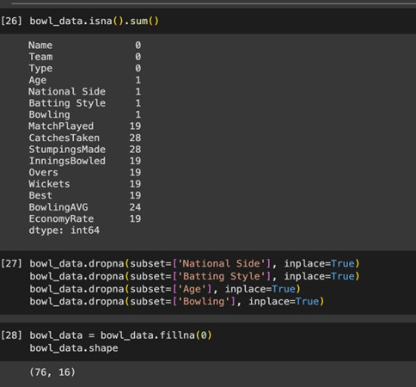
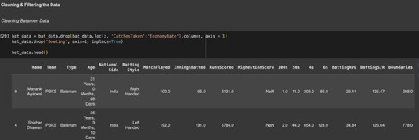

Slide 11
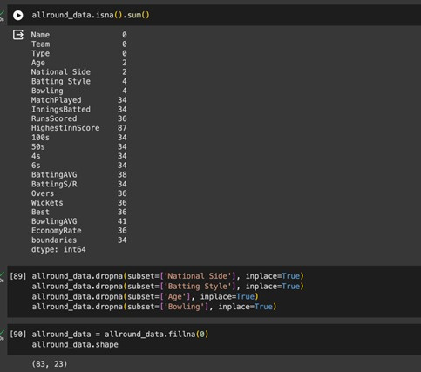
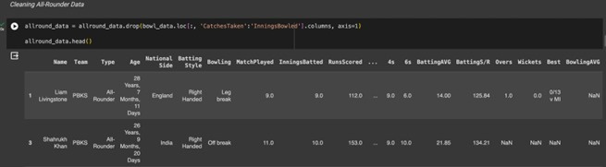
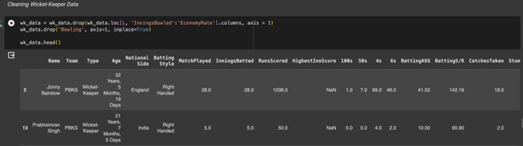
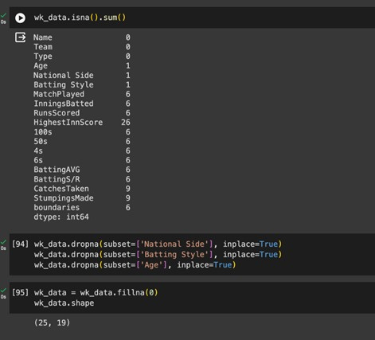

Slide 12
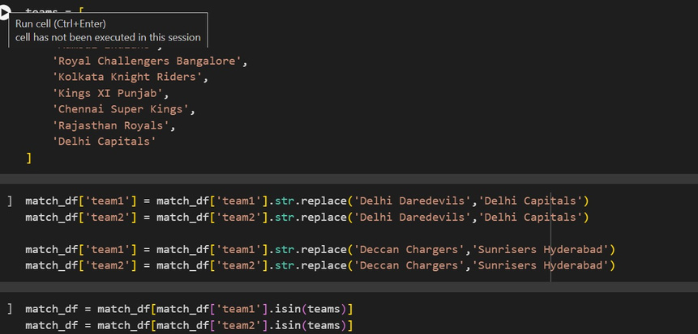
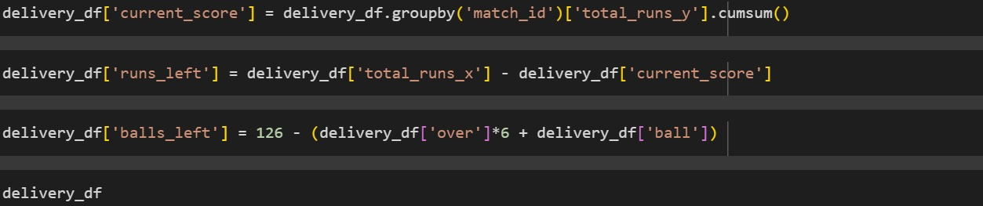

Slide 13
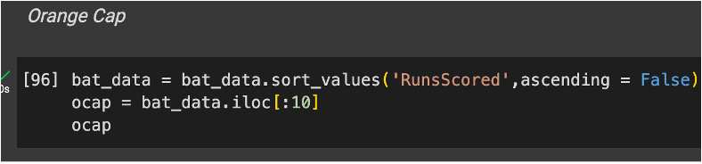
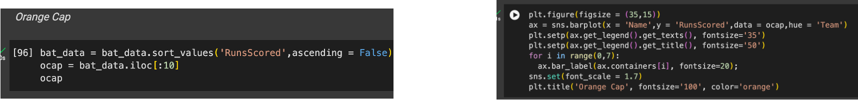
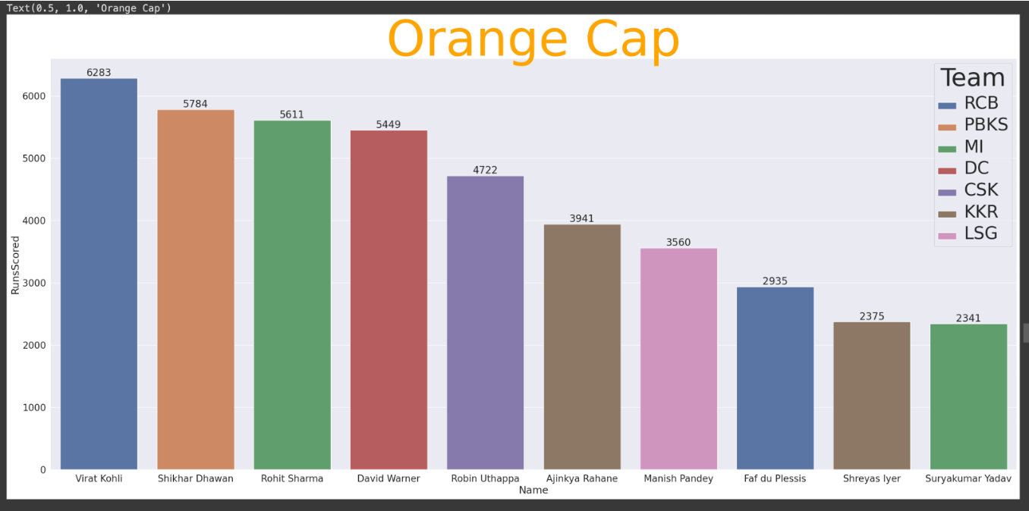
DATA VISUALIZATION

Slide 14
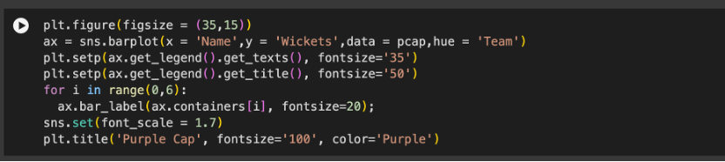
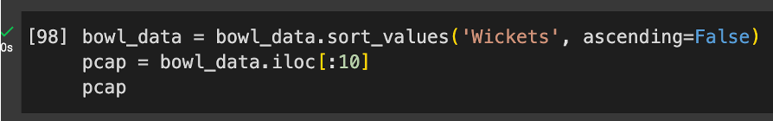
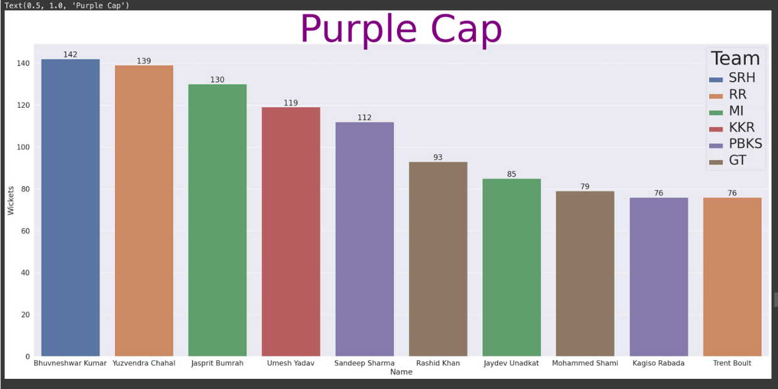
DATA VISUALIZATION

Slide 15
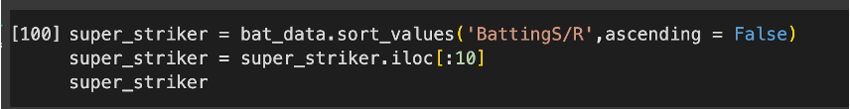
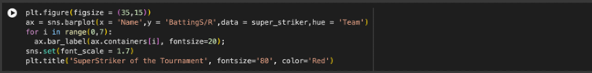
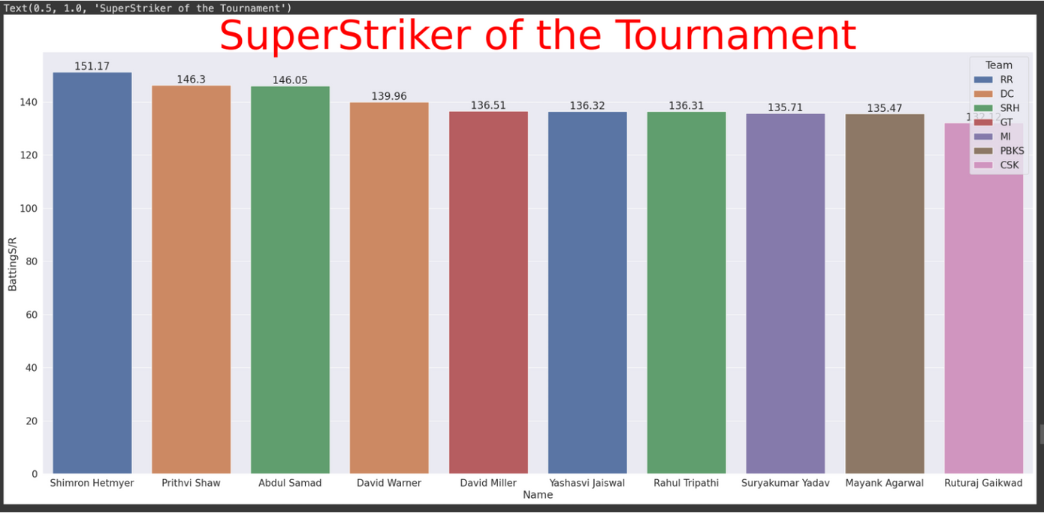
DATA VISUALIZATION

Slide 16
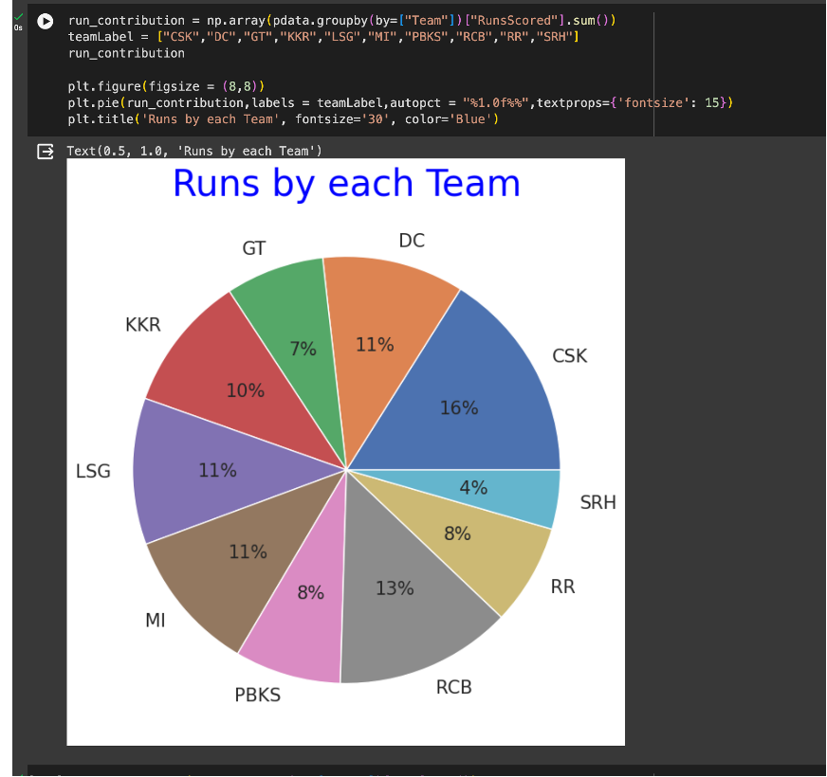
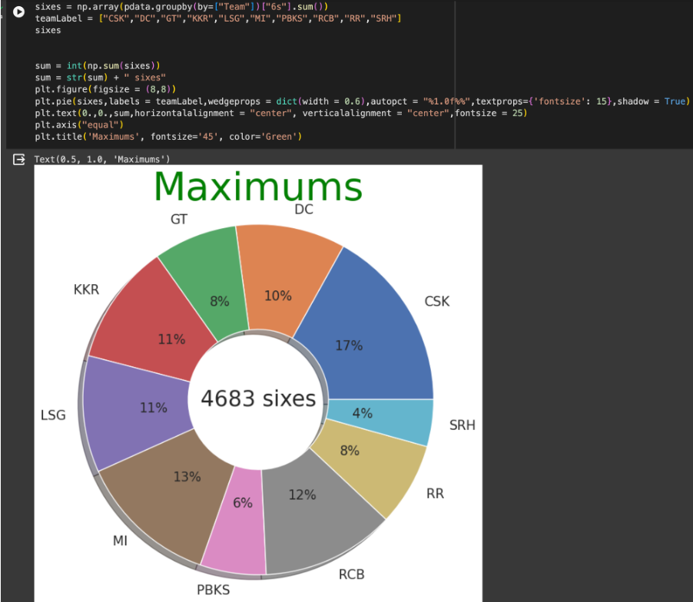
DATA VISUALIZATION

Slide 17
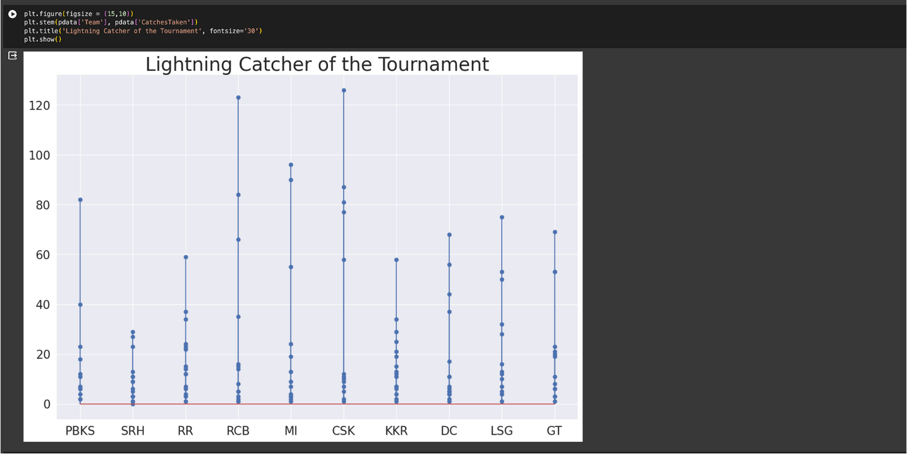
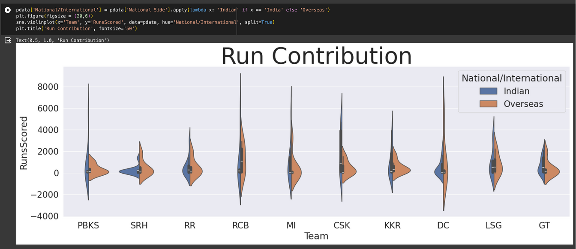
DATA VISUALIZATION

Slide 18
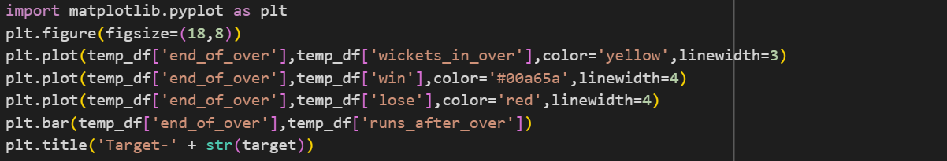
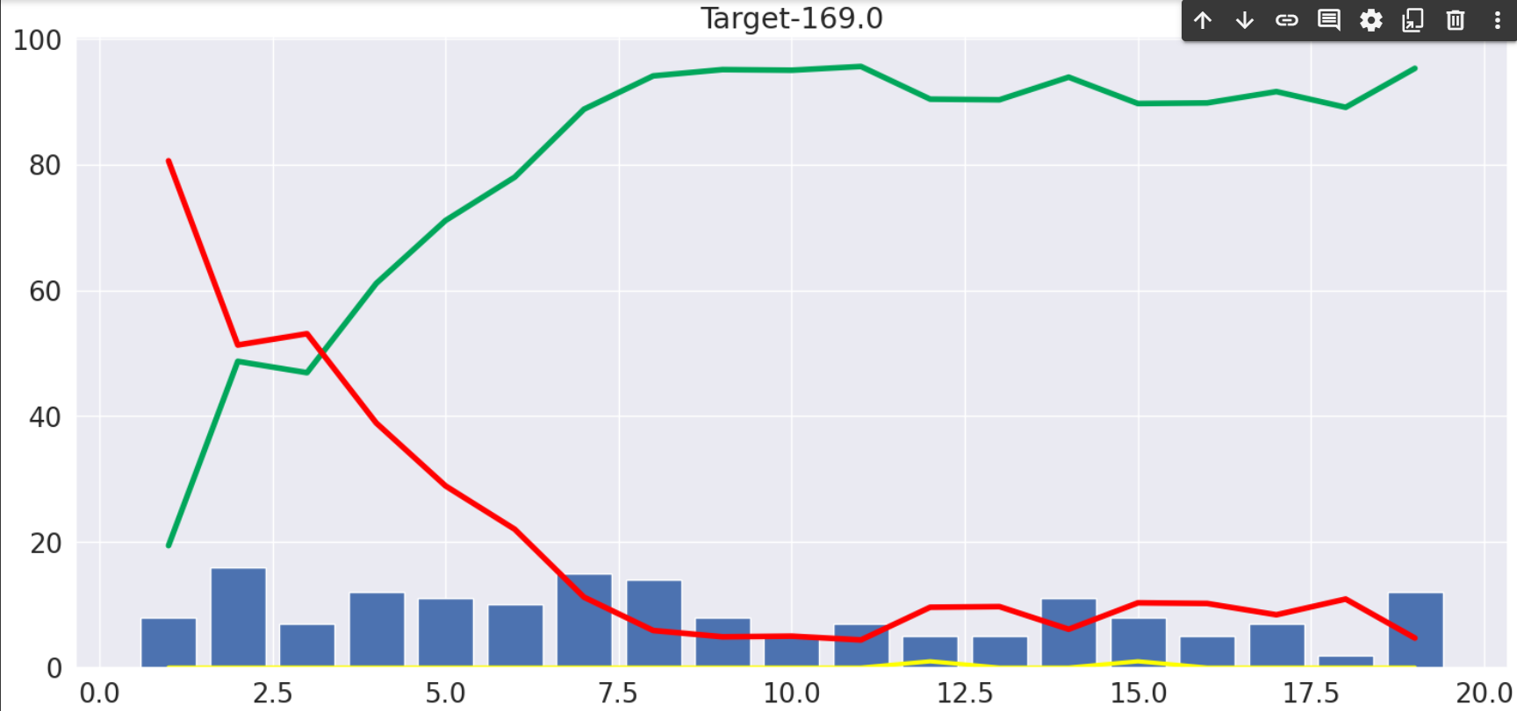
DATA VISUALIZATION

Slide 19
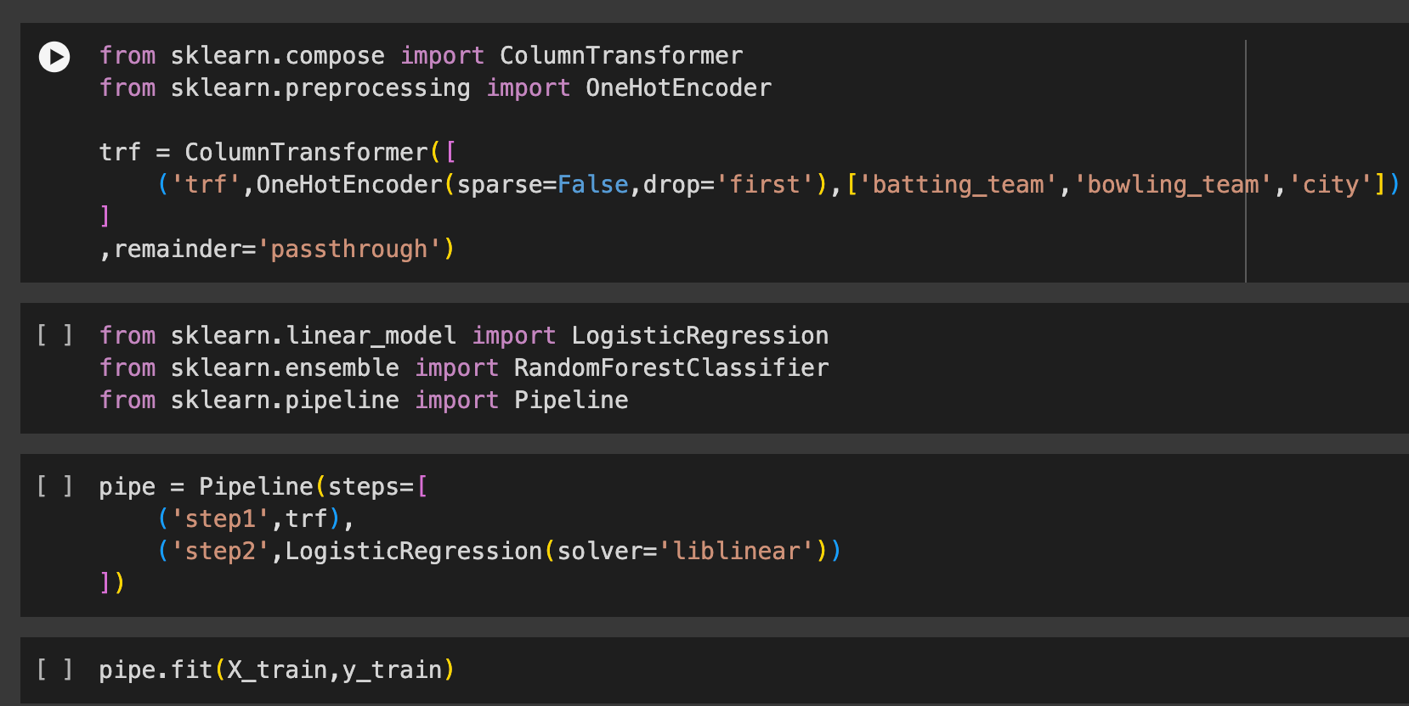
MODEL FORMATION

Slide 20
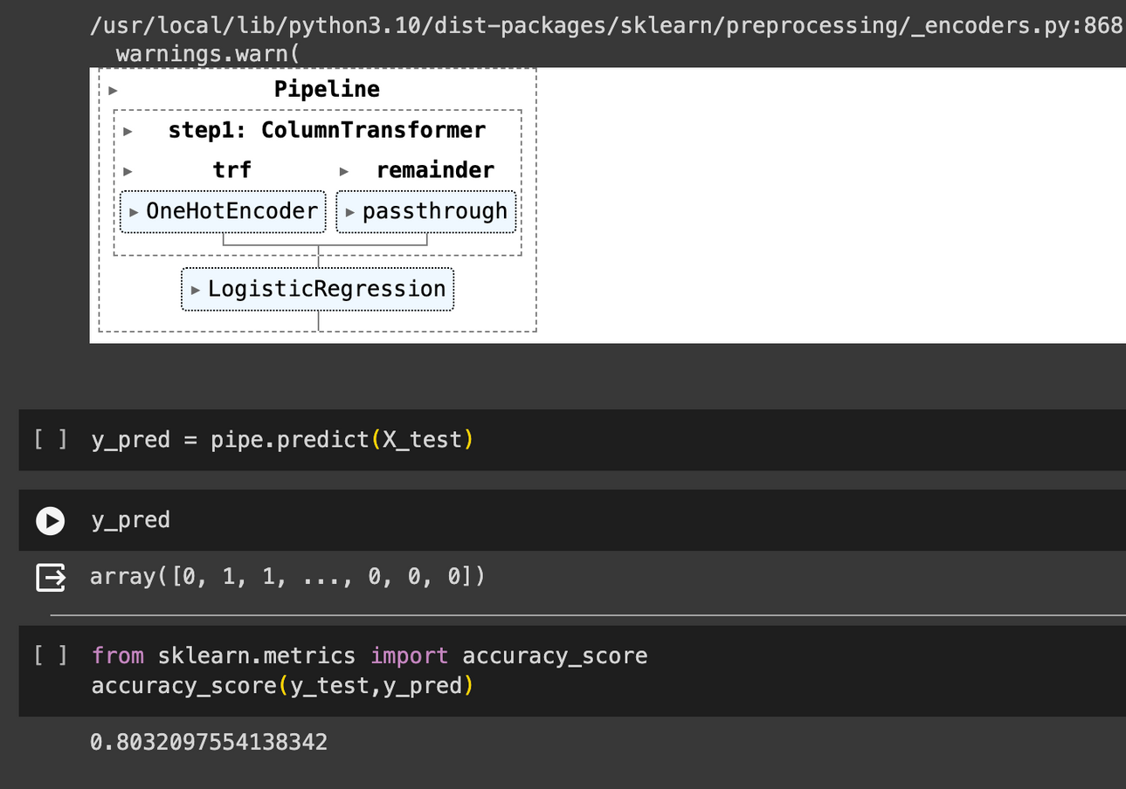
MODEL EVALUATION

Slide 21
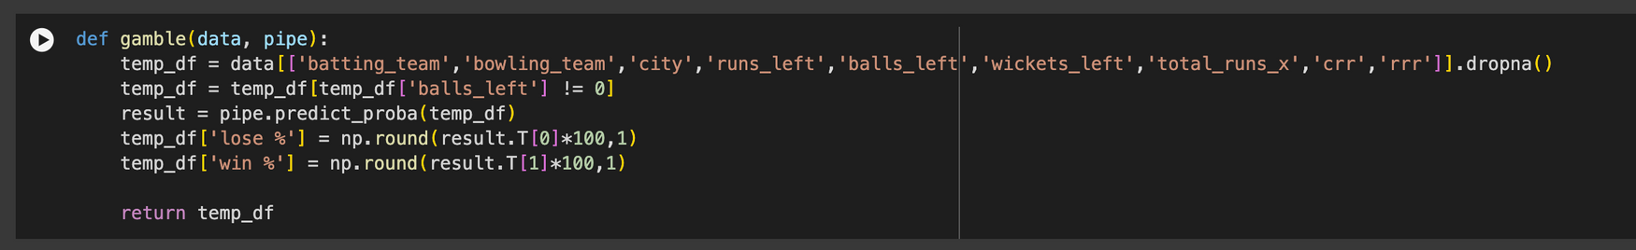
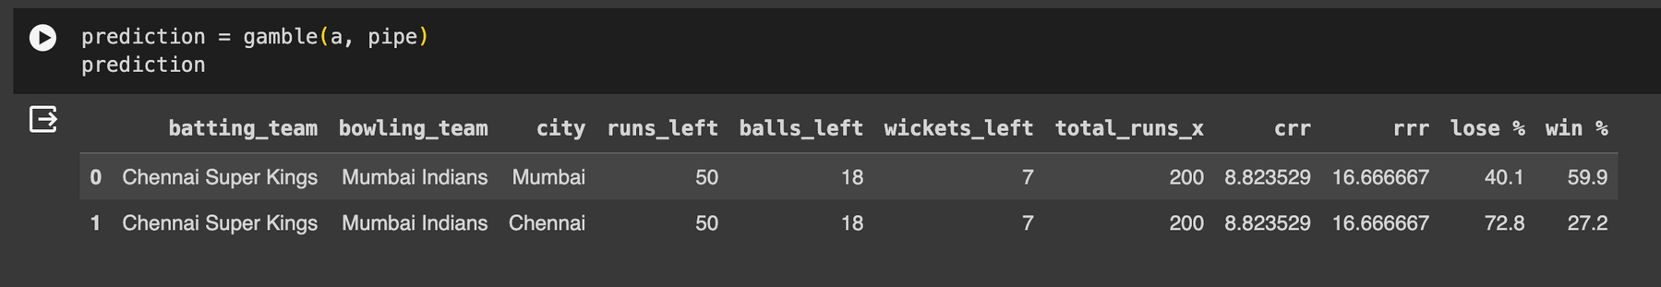
PROBABILITY MODEL
TESTING

Slide 22
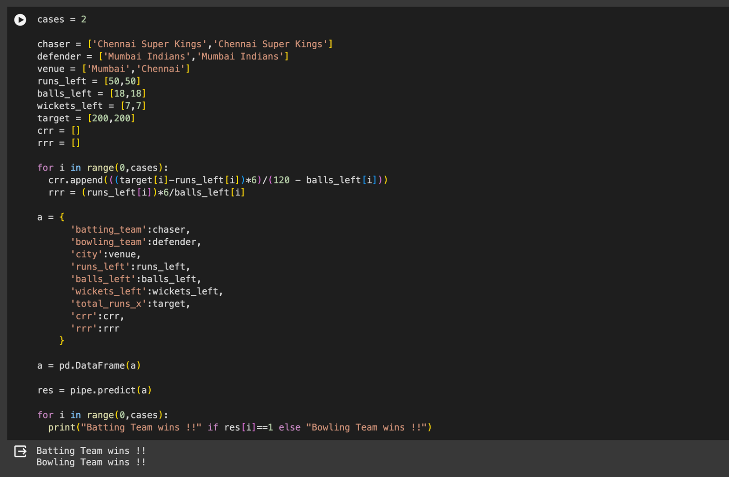
TEST CASES

Slide 23
CONCLUSION
In conclusion, the logistic regression model developed in Python offers a robust framework for predicting wins in a given context. By leveraging this model, we can effectively analyze the relationship between various input features and the likelihood of a win outcome. Through careful feature selection, data preprocessing, model training, and evaluation, we can create a reliable predictive tool. However, it's important to continuously refine the model by incorporating new data and iterating on its design to ensure its accuracy and relevance over time. Overall, the logistic regression approach provides a valuable tool for understanding and forecasting win probabilities, offering insights that can inform decision-making in a variety of fields.

Slide 24
THANK You

